Slide 1
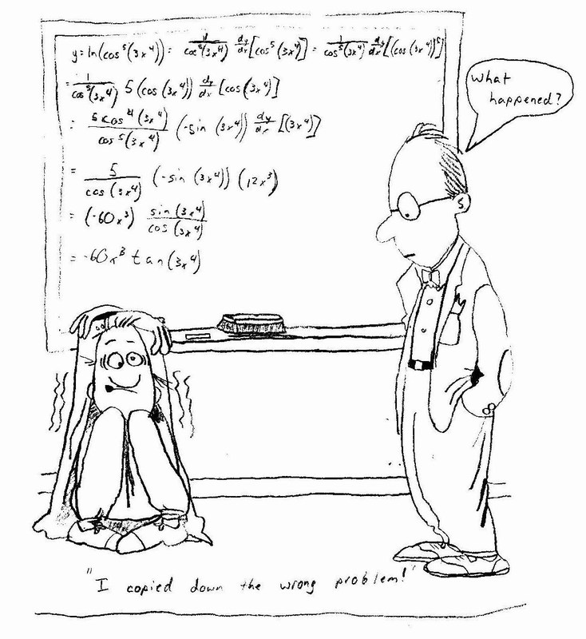
Calc AB Vocabulary
Tips & Tricks

Slide 2
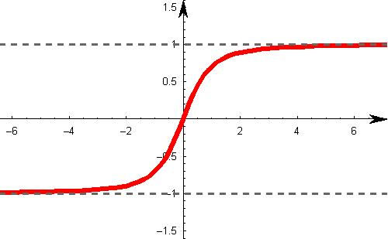
Horizontal Asymptotes
The line y=L is a horizontal asymptote of the graph of f if lim f(x)=L or limf(x)=L
X->
X-> -
8
8
Finding a horizontal asymptote (when looking at exponential degree):
** For negative infinity, after establishing asymptote, plug in a negative number to equation to make sure signs don’t change!
Bottom bigger: y=0
Top bigger: none
Same: Leading coefficients (y=?)
Example:
Graph enclosed by horizontal asymptotes

Slide 3
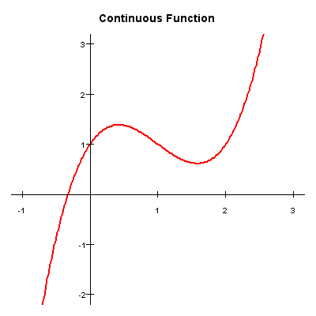
Continuity
A function is continuous on an open interval (a,b) if it is continuous at each point in the interval.
When answering a continuity question, ask yourself these 3 questions:
Is f(c) defined?
Does lim f(x) exist?
Does lim f(x) = f(c)?
** The answers to these questions must be yes in order for a function to be continuous.
X -> C
X -> C
Example:
Solution:
1.) f(1) = 2.
2.)The limit = 3 (1) - 5 = -2 ,
3.)
Condition 3) is not satisfied and function f is NOT continuous at x=1
Notes:
SOLUTION 1 : Function f is defined at x=1 since
i.) f(1) = 2 .
The limit
= 3 (1) - 5
= -2 ,
i.e.,
ii.) .
But
iii.) ,
so condition iii.) is not satisfied and function f is NOT continuous at x=1

Slide 4
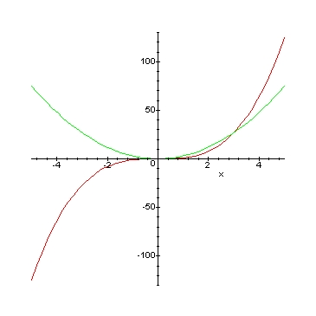
Velocity
How fast something is going at the instant & in which direction.
The instantaneous rate of change of a function.
** Velocity is the derivative of a function
Tips in order to find velocity:
ds/dt= s’(t)=v(t)=lim [s(t+ t)-s(t)]/ t
t-> 0
Example:
Function: Red Derivative: Green
f(x)= 2x⁴-3x³+x
Solution:
f’(x)= 8x³-9x²+1

Slide 5
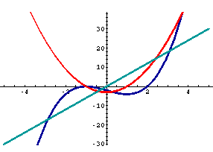
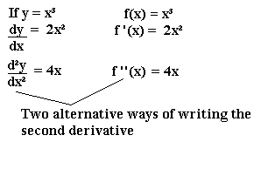
Acceleration
Instantaneous rate of change of velocity.
How quickly a body speeds up or slows down.
How fast velocity is changing with respect to time.
** Acceleration is the second derivative of a function
Tips to help find acceleration:
Function: Teal Velocity: Red
Acceleration: Blue
s’’(t)= d²(s)/dt²
v’(t)= d(v)/d(t)=a(t)
Example:

Slide 6
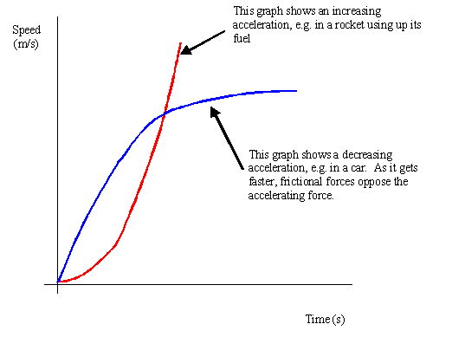
Speed
How fast an object is going no matter which direction.
Measures the rate at which the position changes
Example:
Speed= |velocity|
Speed is increasing when the signs of the acceleration and velocity are either both positive or both negative.
Speed is decreasing if acceleration and velocity have opposite signs.

Slide 7
Differentiation
The process of taking the derivative of a function.
Differentiability implies continuity:
If f is differentiable at x=c then f is continuous at f=c.
Basic differentiation rules & techniques:
d/d(x)[c]=0
Power rule:
d/d(x)[x^{n}]=nx^{(n-1)}
Constant multiple rule:
d/d(x)[cf(x)]=cf’(x)
Sum & Difference rule:
d/d(x)(u +/- v)= du/dx +/- dv/dx
Example:
f(x)=x⁴
f’(x)= 4x³
f(x)=5x⁶
f’(x)= 30x⁵

Slide 8
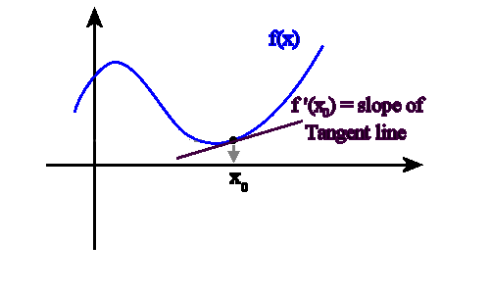
First Derivative
The average rate of change.
Slope of the tangent line.
When dealing with the first derivative of a function:
Slope=m=rise/run=(y₂-y₁)/(x₂-x₁)
The slope of a curve at any given point is the slope of the tangent line to the curve at that point.
Let f(x) be a function:
The first derivative is the function whose value at x is the limit:
f’(x)=lim [f(x+h)-f(x)]/h
h->0
Example:
Solution:
f’(x)= 3x²

Slide 9
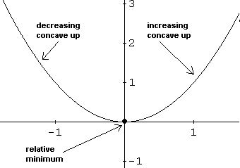
Second Derivative
The second derivative can be used as an easier way of determining the nature of stationary points.
A stationary point on a curve occurs when dy/dx = 0. Once you have estabished where there is a stationary point, the type of stationary point (maximum, minimum or point of inflexion) can be determined using the second derivative
To find out what the second derivative does:
If d²y is positive, then it is a minimum point. dx²
If d²y is negative, then it is a maximum point. dx²
If d²y/dx² is zero, then it could be a max, a min or a point of inflexion.

Slide 10
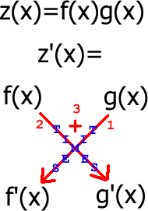
Product Rule
dy/dx[f(x)g(x)]=f(x)g’(x)+g(x)f’(x)
dy/dx[uv]=uv’+vu’
** Product rule is always plus!
Tricks to remember:
First x derivative of second + second x derivative of first
Example:
f(x)=(x²-2x+1)(x³-1)
f’(x)= (2x-2)(x³-1) + (3x²)(x²-2x+1)
=5x⁴-8x³+3x²+2

Slide 11
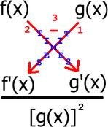
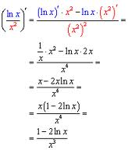
Quotient Rule
dy/dx[u/v]=(vu’-uv’)/v²
** Don’t forget to distribute the negative!
Tricks to remember:
[(bottom x derivative of the top) – (top x derivative of bottom)]/bottom squared
Lo di hi minus hi di lo over lo lo!
Example:

Slide 12
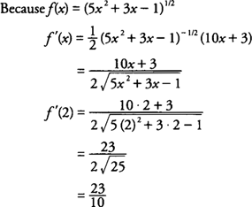
Chain Rule
d/d(x)[f(g(x))]=f’[g(x)]g’(x)
** Don’t forget derivative of the inside!!
Tricks to remember:
Bring exponent down to the front.
Subtract one from the exponent.
Multiply by the derivative of the inside equation.
Example:

Slide 13
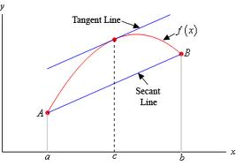
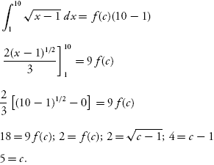
Mean Value Theorem
If f is continuous on the closed interval [a,b] & differentiable on the open interval (a,b) then there exists a number c in (a,b) such that: f’(c)=[f(b)-f(a)]/[b-a]
** MVT in short: The average rate of change over the entire interval is equal to the instantaneous rate of change at some point on the interval (a,b).
To determine if the MVT applies:
Do derivative of the equation.
Plug in interval points on right side of equation.
Solve for x (factor, quadratic, etc.)
Example:

Slide 14
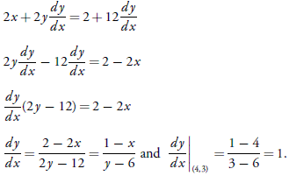
Implicit Differentiation
Implicit differentiation is used when you are unable to solve explicitly for y.
Steps to finding dy/dx for implicitly defined relations:
Differentiate both sides with respect to x.
Collect dy/dx terms on one side & all other terms on other side.
Factor out dy/dx.
Solve for dy/dx.
**Don’t forget to plug in dy/dx everywhere you take the derivative of a y!
Example:

Slide 15
Logarithmic Differentiation
y=x^{x}
When there is a variable in the base and exponent, as above, logarithmic differentiation is necessary.
To take the derivative of logarithmic functions:
ln both sides.
Bring down exponent.
Do derivative of x side
Do derivative of y side.
Simplify (bring y over).
Turn into terms of x (using original equation).
Example:
lny=x^{x}
lny=xlnx
=x(1/x)+lnx
y’/y=
y’=(1+lnx)y
y’=(1+lnx)x^{x}

Slide 16
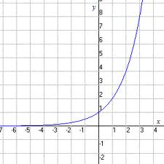
Exponential Derivatives
The inverse function of the natural logarithmic function f(x)=lnx is the natural exponential function and is denoted by f⁻¹(x)=e^{x}
To take the derivative of exponential functions:
d/d(x)[e^{x}]=e^{x}
d/d(x)[e^{u}]=u’(e^{u})
** Don’t forget to multiply by the derivative of the exponent!
Exponential Graph
Example:
f(x)= e ^{4x+1}
f’(x)= 4(e ^{4x+1})

Slide 17
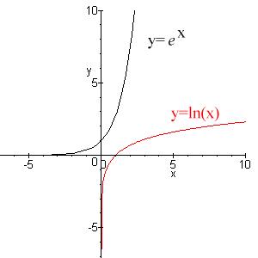
Derivatives of Ln
d/d(x)(lnx)=1/x
d/(x) (lnu)= u’/u when u>0
Things to remember about Ln’s:
ln(1)=0
ln(ab)=lna+lnb
ln(a^{n})=nlna
ln(a/b)= lna-lnb
Example:

Slide 18
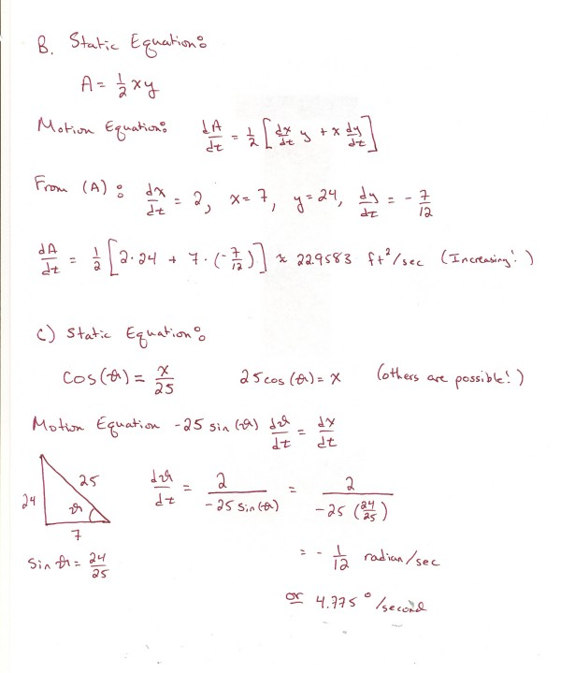
Related Rates
Problems involving finding a rate that a quantity changes by relating that quantity to other quantities whose rates of change are known.
How to set up a related rate problem:
Example:
Draw a diagram.
Read the problem & write “find=” “when=” “given=” with appropriate information.
Write the relating equation & find derivative of both sides of the equation remembering to put d(something)/dt for the variables that change with respect to time.
Substitute “given” & “when” then solve for “find.”

Slide 19
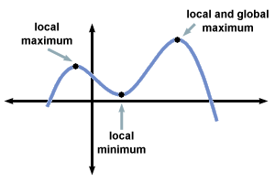
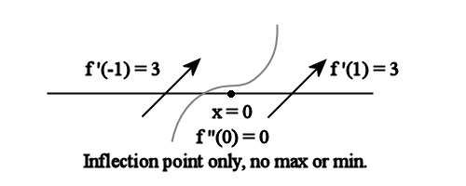
Local Maximum/Minimum
A local maximum is the maximum value within an open interval.
A local minimum is the minimum value within an open interval.
If a function has a local maximum value or local minimum value at an interior point c of its domain & if f’ exists at c: f’(c)=0.
Finding the critical points (max/min):
Find derivative.
Set equal to 0.
After plugging in a number larger than, and smaller than the critical points on the interval, determine if at the point the sign changes from positive to negative (max) or negative to positive (min).
Example:

Slide 20
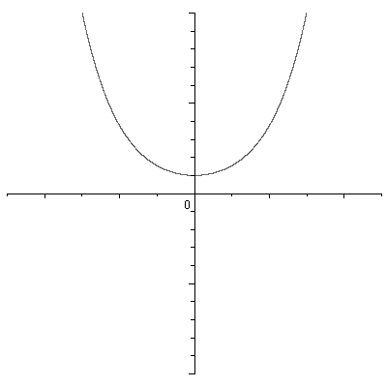
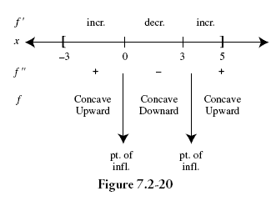
Concavity
A differentiable function f is:
Concave up if f’(x) is increasing at f’’(x)>0
Concave down if f’(x) is decreasing at f’’(x)<0
To test for concavity:
** Point of inflection is where it changes signs!
If y’’>0 or undefined then y=CCU (above tangent lines)
If y’’<0 or undefined then y=CCD (below tangent lines)
Concave down
Concave up
Example:

Slide 21
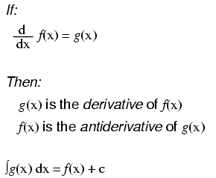
Integration
The process of taking an antiderivative, a function F whose derivative is the given function ƒ.
The expression: is read as antiderivative of f with respect to x so the differential dx serves to identify the x as the variable of integration. The rules are:
0dx=c
kdx=kx+c (where k=constant)
You can pull constant out in front.
x^{n}dx=(x^{n}+1)/(n+1) +c (where n is not equal to 1)
Example:

Slide 22
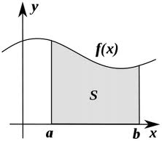
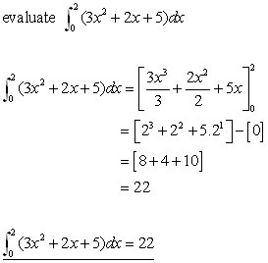
Area
Found with an integral, the area represents the signed area between y=f(x) and the interval [a,b] that is a definite integral can be a negative or positive number (profit, distance, consumption, etc.). However, if it represents area then the region is bounded by the x axis and vertical lines x=a and x=b, which is always positive.
Area = top curve – bottom curve

Slide 23
Integration by substitution
Used for complex integration.
Steps for “u” substitution:
Choose “u” (inner part of composition) under radical, in parentheses, or attached to trig function.
Compute “du” derivative of “u”.
Rewrite in terms of “u”.
Evaluate integral.
Substitute back (switch “u” so there are no “u’s” in final answer.
Example:
3x²sinx³dx
1. u=x³
2. du=3x²
3. sinudu
sinudu=-cosu +c
-cosx³+c

Slide 24
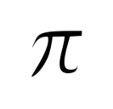
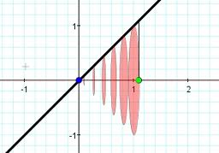
Volume by the Disk Method
To find the volume of a solid of revolution with the disk method, use one of the following:
Horizontal method of revolution:
ª
volume=V= [R(x)²]dx
^{b}
Vertical method of revolution:
^{d}
volume=V= [R(y)]²dy
Example:
^{c}
Find area bounded by: f(x)= (3x-x²)^{1/2}
and the x axis 0<x<3
[(3x-x²)^{1/2} -0] ²
³
⁰

Slide 25
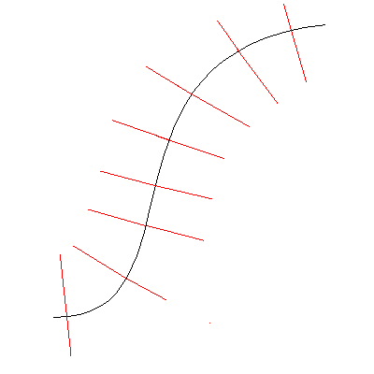
Normal Line
The line that is perpendicular to the tangent line at the point of tangency.
Finding the normal line:
The line that is a negative reciprocal of the derivative.
Example:
If f′(−1)=−½ and the slope of the normal line is −1/ f′(−1) = 2; hence, the equation of the normal line at the point (−1,2) is:

Slide 26
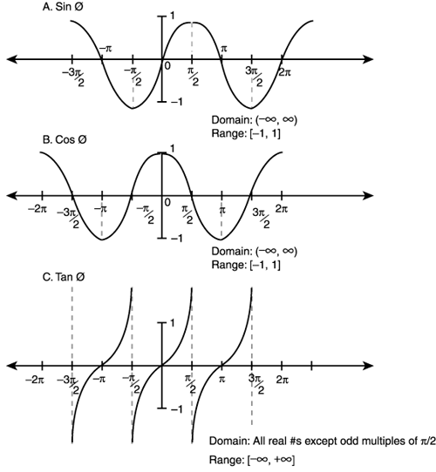
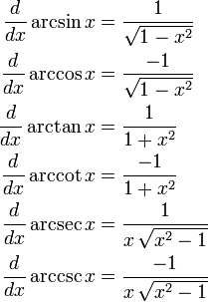
Inverse Trig Functions
The derivative rules for inverse trigonometric functions

